Slide 1
Presented by :
Israt Jahan Ahmed
Muhammet Hamza Hoxha
Oliver Seekins
Sofia Stender
Rashna Habib Ullah
Sanka Wijayarathne
Mohammed Yusuf
5th December 2021

Slide 2

Content
Background
Roles
Issue
Solution
Benefits/Drawbacks
Ideas
Marketing
Finance – Agilisys
Finance – Investment
Sustainability
Conclusion
Timeframe
References
(Others can be changed?)

Slide 3

Background
From 1998, Agilisys has partnered with healthcare, local government and organisations to provide services using technology using deliverables:
future-fit infrastructure
intelligent operations
smarter service solutions
future planning

Slide 4

Roles
Israt Jahan Ahmed – Chief Finance Officer
Muhammet Hamza Hoxha – Marketing
Oliver Seekins – Sustainability
Sofia Stender -
Rashna Habib Ullah – Software Engineer
Mohammed Yusuf - CEO
Sanka Wijayarathne -

Slide 5
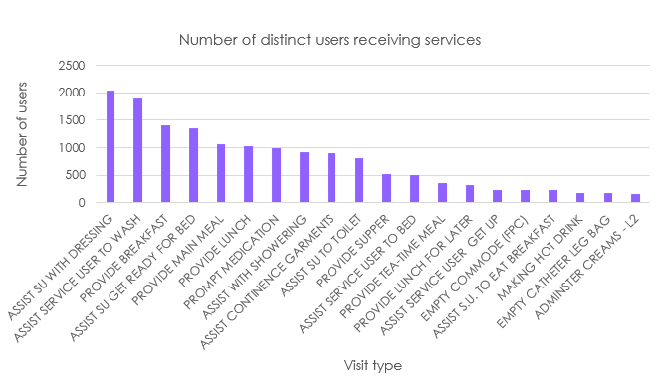
Issues
According to ONS (2019), the UK population is ageing, with over 16 million people aged 60 or over, making up 24% of the UK population.
When looking at a Local Authority, it can be seen 56,000 home care visits are provided per week to about 3,000 service users, which costs £18 per hour
Figure: Trend in home care services delivered

Slide 6

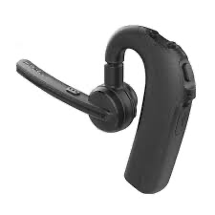

Solution
Smartwatch, Robots and Ear speakers help:
Apps can connect to smart devices, such as to turn on kitchen supplies
Robot uses Artificial Intelligence to move hardware to open kitchen supplies
Calls can be directed to emergency lines when suited

Slide 7
Benefits
Drawbacks
Independence increase for people aged 60 or over
Fewer money is used in care services
Increased marketing of Agilisys company
Environmentally friendly
People aged 60 or over may need assistance with understanding the technology
Expenses with providing the objects, electricity bills and care assistance
Technology is not reliable

Slide 8
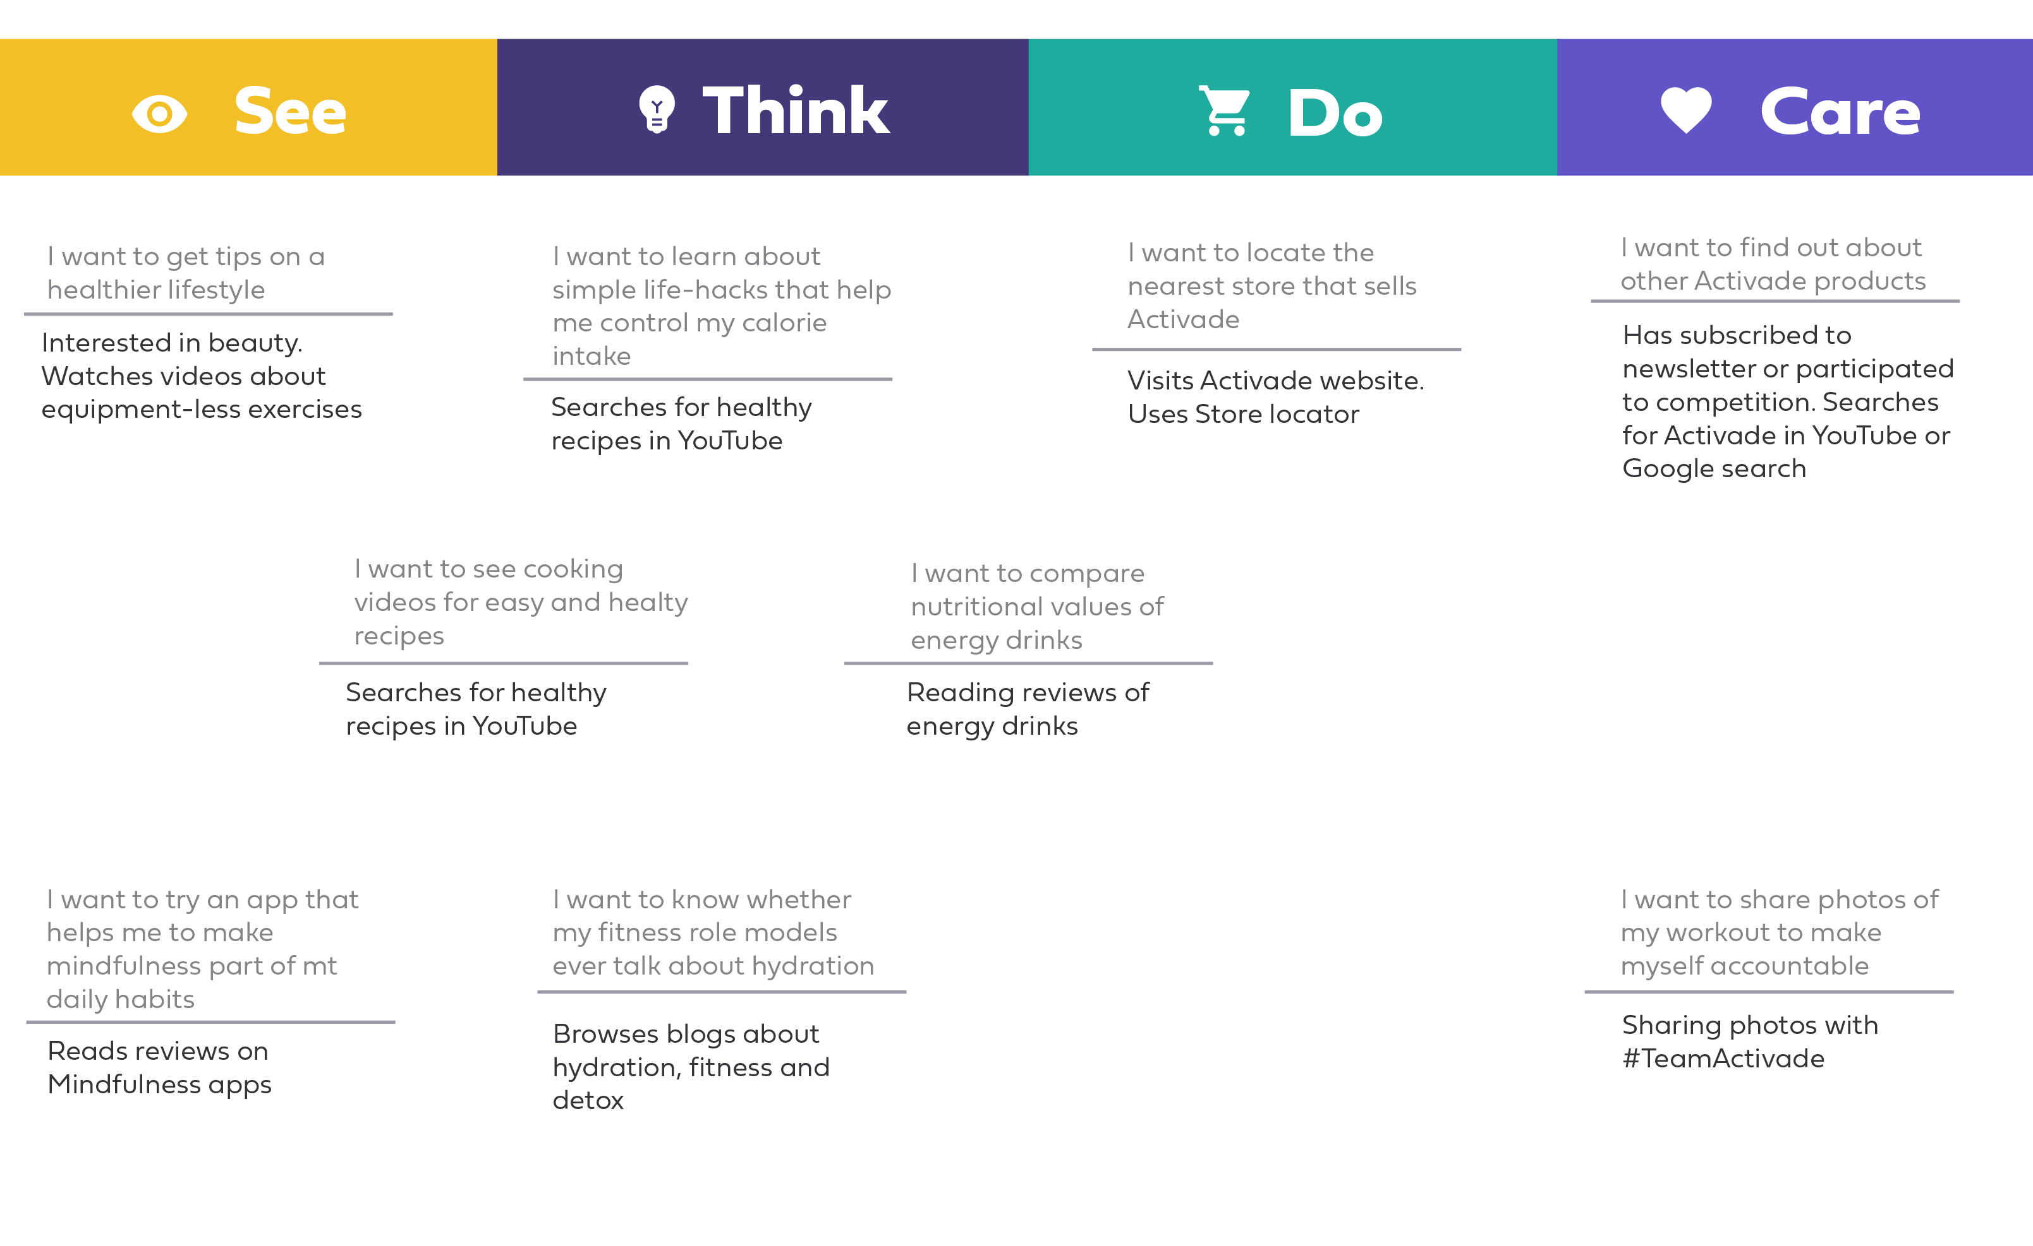
Ideas
See | Think
Do | Care

Slide 9
Marketing

Slide 10

Finance - Agilisys
Cost of manufacturing:
Smartwatch – £63.06
Robot - £18 836
Ear Speaker – £752.69
Software Engineer – £44,851/year
Transport:
NHS
Driver - £8/hour

Slide 11
Finance - Investment
Bank:
Loan
Businesses:
Apple
Samsung
Etc.

Slide 12

Sustainability
Following COP26 we have decided to make our process net carbon zero.
This will be applied throughout the production, operation and supply chain.
Composite materials will be used throughout production and to create the robot and devices.
Factories and warehouses will be devised in an eco manor with solar power and forestation planted within the surroundings.
Transportation will be via electric and hydrogen methods within the UK, optimizing the use of the new Mercedes hydrogen lorry.
To transport internationally we will use a significant amount of carbon, however this will be offset through eco friendly activities in the UK, for example, planting trees for wildlife.

Slide 13
Conclusion

Slide 14

Timeframe

Slide 15
References

